Slide 1











Title: Sentiment Analysis of Bangla E-commerce Dataset: Using Different Machine & Deep Learning Models
Date: 25th September, Wednesday, 2024
Team Members:
Name: Misbahul Sheikh
ID: 20200204039
Name: Naushin Mamun
ID: 20200204010
Name: Nafisa Tasnim Neha
ID: 20200204020

Slide 2
Table of Content
Abstract
Motivation
Literature Review
Methodology
Data Collection
Data Processing
Feature Extraction
Data Splitting
Result Analysis
References

Slide 3
1
Abstract
Analyze customer sentiment in Bangla e-commerce.
Use various machine learning and deep learning models.
Focus on data preprocessing.
Evaluate and compare model effectiveness.
Provides valuable insights into model applicability.
.
.

Slide 4
2
Motivation
Increases online transactions and customer interactions in Bangladesh.
Essential for enhancing satisfaction and engagement.
Analyzes customer opinions via textual data.
Lack of focus on Bangla sentiment analysis in e-commerce.
Tackles Bangla linguistic challenges, highlighting NLP and machine learning's impact.
Develop techniques to improve business strategies.

Slide 5
3
Literature Review
01
02
03
04
Models Used:
KNN, SVM, RF, LR, XGBoost
Highest Accuracy:
KNN at 96.25%
Other Accuracies:
SVM: 94.35%
RF: 90.84%
LR: 90.33%
XGBoost: 90.56%
Models Used:
SVM, Multinomial Naïve Bayes, LR
Highest Accuracy:
SVM at 86%
(Focused on analyzing sentiment in Bangla movie and short film scripts)
Models Used:
SVM, Multinomial Naïve Bayes, KNN, LR, Decision Tree, and RF
Highest Accuracy:
SVM: 85.59%
MNB: 85.15%
(Analyzed Bangla conversations)
Models Used:
CNN, LSTM, Hybrid CNN-LSTM
Embedding Layers: Word2Vec, CBOW, Glove
Highest Accuracy:
CNN-LSTM hybrid with Word2Vec embedding at 90.49% accuracy,
F1-score of 0.9283.

Slide 6
Methodology
4
Data Collection
Data Preprocessing
Feature Extraction
4 classes:
positive
very positive
Negative
very negative
Removing
Non-Bengali text
URL
Digits & Numbers
Punctuation & Emojis
Tokenization
Lemmatization
TF-IDF
Convert multi-class to binary class
0-> Very positive & positive
1-> Very negative & negative
Train Data
80%
ML Model
KNN
RF
LR
SVM
Result Analysis
Accuracy
Precision
Recall
F1-score
Comparison
Data Splitting
Test Data
20%
DL Model
LSTM
Validation
Data
20%
Fig 1. Total Workflow

Slide 7
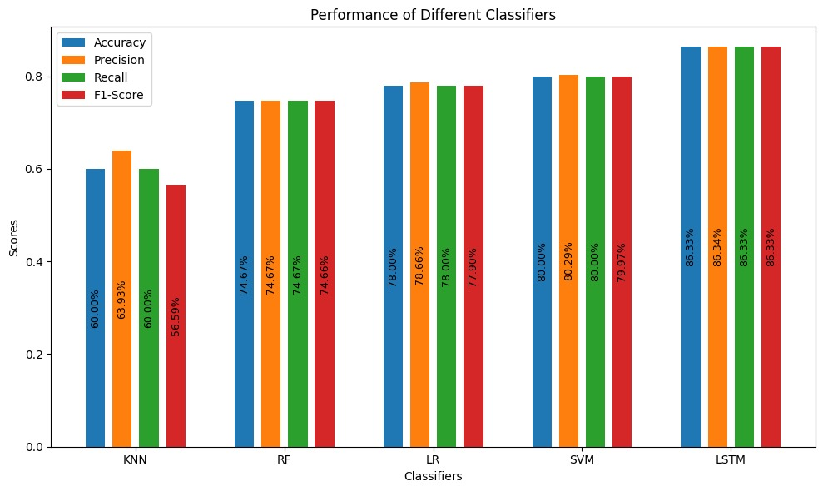
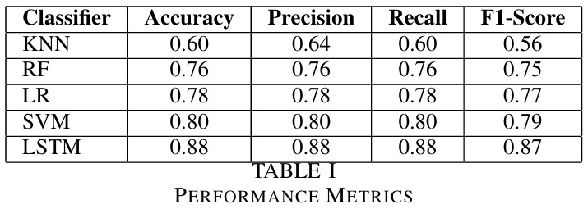
5
Result Analysis
Fig 2. Result Table
Fig 3. Result in Bar Diagram

Slide 8
6
Conclusion
LSTM: Best performance with 88% accuracy; precision, recall, and F1-score are 0.88, 0.88, and 0.87, respectively.
SVM: Second-best with 80% accuracy.
KNN: Lowest performance with 60% accuracy.

Slide 9
7
References
[1] Mst. Tuhin Akter, Manoara Begum, and Rashed Mustafa, “Bengali Sentiment Analysis of E-commerce Product Reviews using K-Nearest Neighbors,” 2021 International Conference on Information and Communication Technology for Sustainable Development (ICICT4SD), 27-28 February, Dhaka.
[2] Abdullah Al Jamil, Rahman,Rifat, “Sentiment and Emotion Analysis from Textual Data in Bangla Language,” Southeast University Journal of Computing Sciences, Volume 01, No 01, June 2021
[3] Mahmudul Hassan, Shahriar Shakil, Nazmun Nessa Moon, Mohammad Monirul Islam, Refath Ara Hossain, Asma Mariam, Fernaz Narin Nur, “Sentiment analysis on Bangla conversation using machine learning approach,” International Journal of Electrical and Computer Engineering (IJECE) Vol. 12, No. 5, October 2022, pp. 5562 5572.
[4] Muntasir Hoq, Promila Haque, and Mohammed Nazim Uddin, “Sentiment Analysis of Bangla Language Using Deep Learning Approaches,” Springer Nature Switzerland AG 2021 N. Chaubey et al. (Eds.): COMS2 2021, CCIS 1416, pp. 140–151, 2021

Slide 10
8
THANK YOU VERY MUCH!

